Slide 1
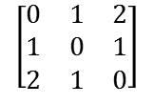
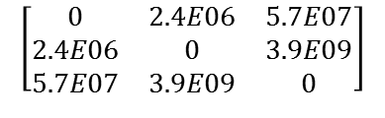
=
Calculate Distance Matrix
$$\left[\begin{matrix}0 & 2.4E06 & 5.7E07 \\ 2.4E06 & 0 & 3.9E09 \\ 5.7E07 & 3.9E09 & 0\end{matrix}\right]$$
kNN
$$\left[\begin{matrix}0 & 1 & 2 \\ 1 & 0 & 1 \\ 2 & 1 & 0\end{matrix}\right]$$
⨝
Image volume
Image Volume
Cross Join along Image Dimension
All Pairs of Images
All Pairs Distance Matrix
All Pairs Nearest Neighbors Result

Slide 2
Weighted Image Average

Slide 3
Fixed Image Patch Extraction

Slide 4
Image Convolution

Slide 5
All Pairs Nearest Neighbors

Slide 11
Image Set 1
Image Set 2
Image Set 3
Image 1
Image 1
Image 1
Image 1
Image
2
Image 3
Open And Process in Parallel
All Nodes
Result 1
Result
2
Result3
MPI_Gather
Image 1
Image
2
Result Array
Master Node Only
Final Result

Slide 12
Image Set 1
Image Set 2
Image Set 3
Image 1
Image 1
Image 1
Image 1
Image
2
Image 3
Open And Process in Parallel
All Nodes
Result Set 1
Result
Set 2
Result Set 3
Result 1
Result
2
Result3
Result 1
Result
2
Result3

Slide 14
Image-array1
Image-array2
Image-array3

Slide 15
images_array

Slide 16
Coordinator Node
SciDB Clients
(iquery, SciDB-py, SciDB-R etc.)
SciDB
Engine
PostgreSQL
(System Catalog)
Local Store
SciDB
Engine
SciDB
Engine
SciDB
Engine
SciDB
Engine
Local Store
Local Store
Local Store
Local Store
Worker Nodes

Slide 17
image
patch
slice
result

Slide 18
image
patch
slice
result

Slide 19
Instance Store
Instance Store
Instance Store
Instance Store
Master
Slave
1
Slave
2
Slave
N-1
NFS Server

